Slide 1

Book Recommendation
By Group 1:-
Mr. Parth Suhas Mane
Mr. Sushant Sadanand Kashikar
Mr. Abhishek G
Miss. Shruthi Shankar Molawade
Miss. Vundavalli Swetha Bindu
Miss. Annamreddy Jyotshna
Mr. Gogula Madhu

Slide 2

PROJECT OBJECTIVES:
PROBLEM STATEMENT
EDS(EXPLORATORY DATA ANALYSIS)
MODEL BUILDING
MODEL EVALUATION
DEPLOYMRENT

Slide 3
Problem Statement
Create the attributes from the dataset and utilize them to propose the books in accordance with the user's preferences.

Slide 4
Importing Datasets:
We used pandas to read the data from the data set.
Datasets or Data files:
Users
Books
Ratings
Users:
User-Id
Location
Age
Books:
ISBN, Book-title, Book author, Year of publication, publisher, image URL-S, M, L
Ratings:
User-Id, ISBN, Booking-rating

Slide 5
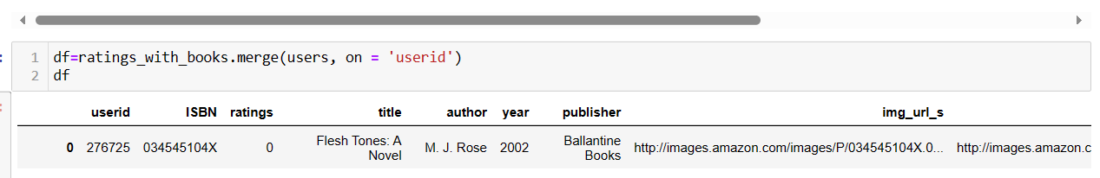
Merging Datasets:
Merged dataset of rating and books through ISBN column into new dataset of ratings_with_books.
Merged dataset of ratings_with_books and users through userid column into new dataset named “df”.
df :
ISBN, userid, ratings, title, year, author, age, location, image-s,m,l.

Slide 6
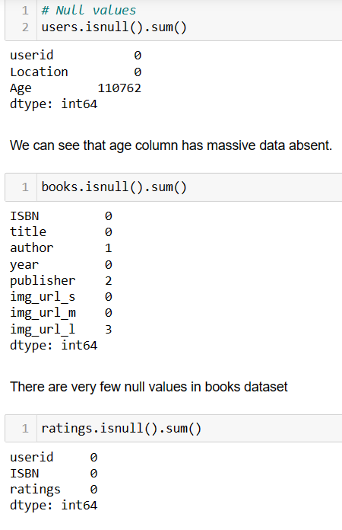
EDA(EXPLORATORY DATA ANALYSIS)
Shape of Dataset:
Users:
Rows - 278858 and Columns - 3
Books:
Rows - 271360 and Columns - 8
Ratings:
Rows - 1149780 and Columns – 3
Null Values:
Users - Age – 110762(Highest null values)
Dropped age from Dataset

Slide 7
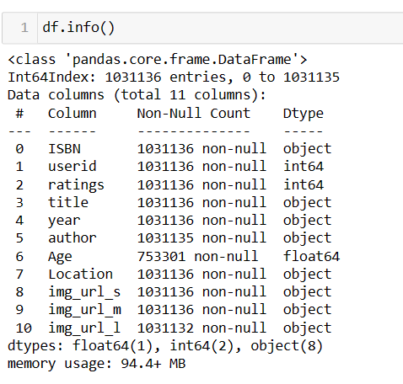
Information of df:
Duplicate values:
No duplicate value in 3 datasets
Shape of DF(Merged all into one dataset)
Rows – 1031136 and Columns – 11

Slide 8
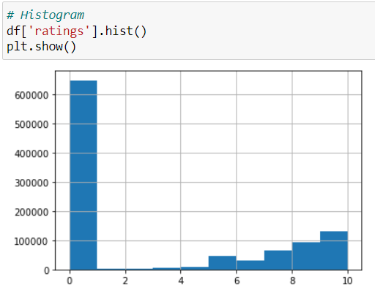
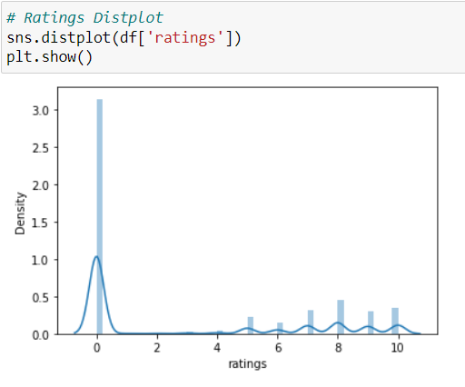
Data Visualization
Histogram
Distplot

Slide 9
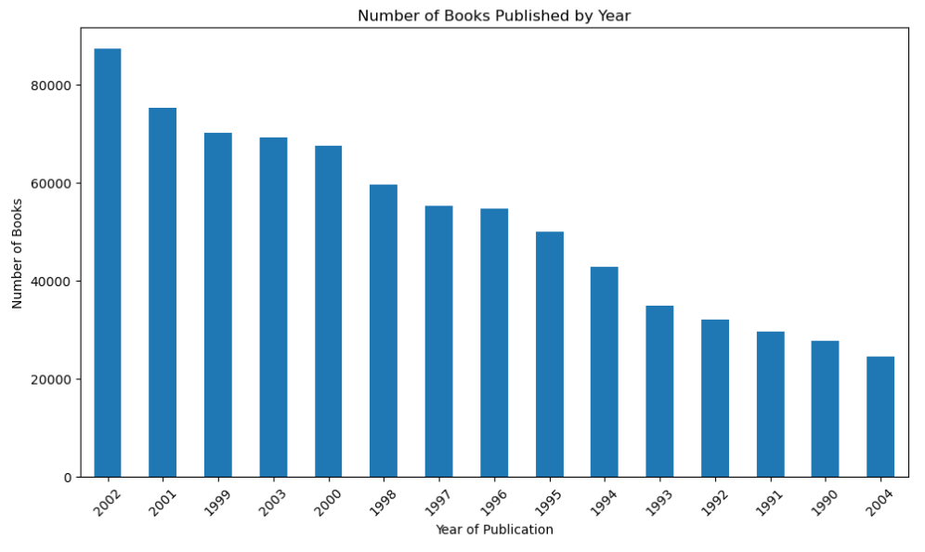
Skewness of data: 0.7524189628269683
Number of Books Published:
Highest number of books published in the year 2002
Lowest number of books published in the year 2004

Slide 10
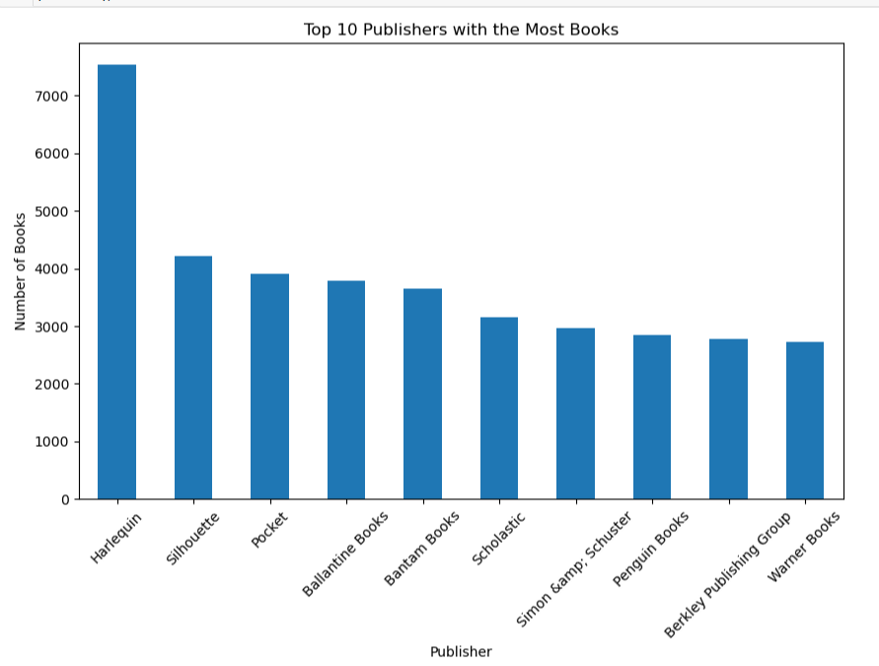
Top 10 Publisher:
Harlequin publishers are in the top where they published over 7000 books.

Slide 11
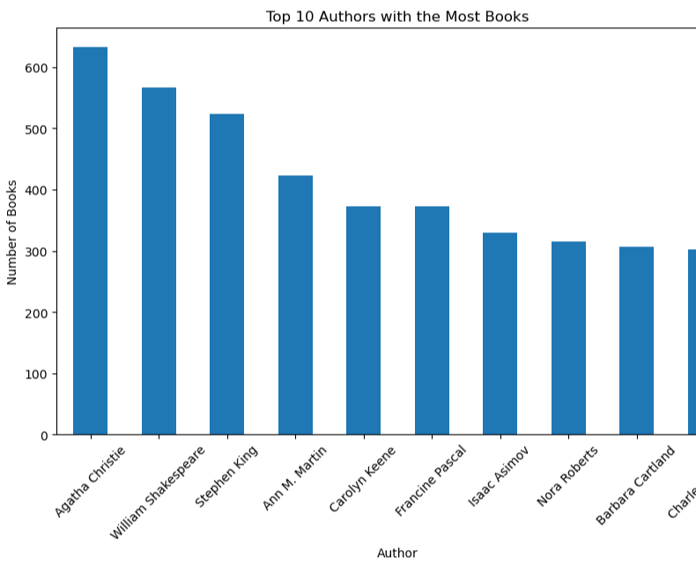
Top 10 Authors:
Agatha Christie was the author who wrote more than 600 books.

Slide 12
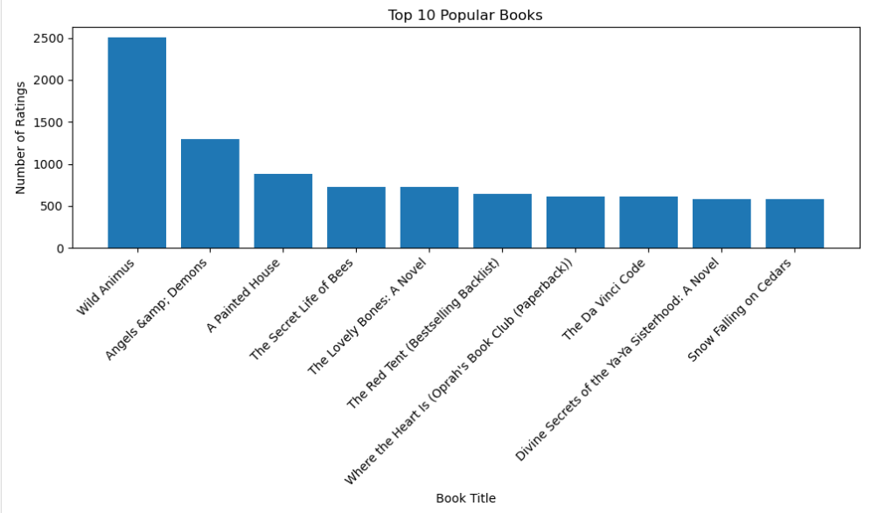
Top 10 Popular Books:
Wild Animus was the popular book which got highest ratings around 2500.

Slide 13
Model Building

Slide 14
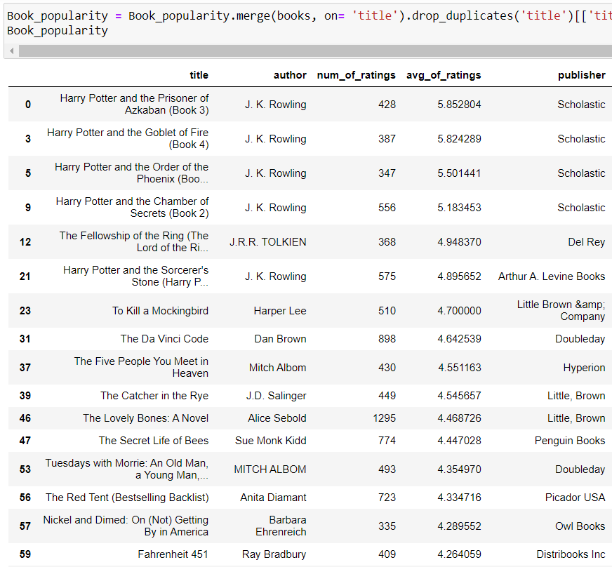
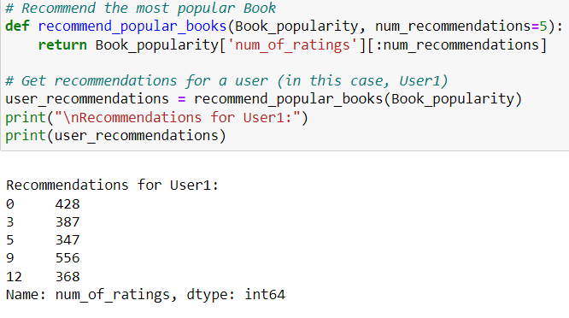
1.Popularity Based Model Building
Dataframe
Created a Dataframe with books that are rated maximum number of times.
Then Sorted Dataframe with books that have been rated more than 300 times.
Model:

Slide 15
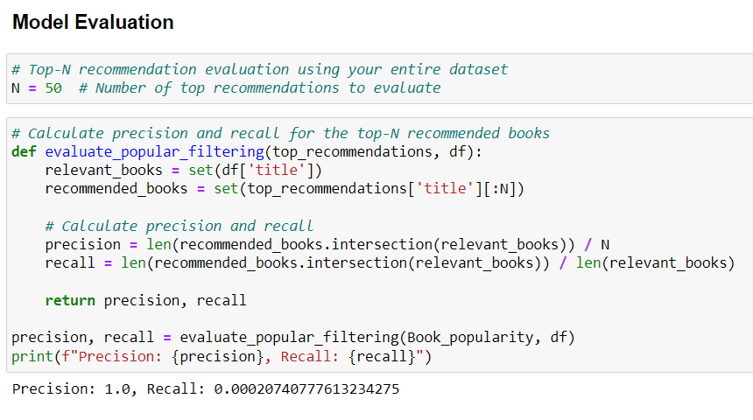
Model Evaluation for Popularity based
Here we got
Precision :- 1.0
Recall:- 0.0020

Slide 16
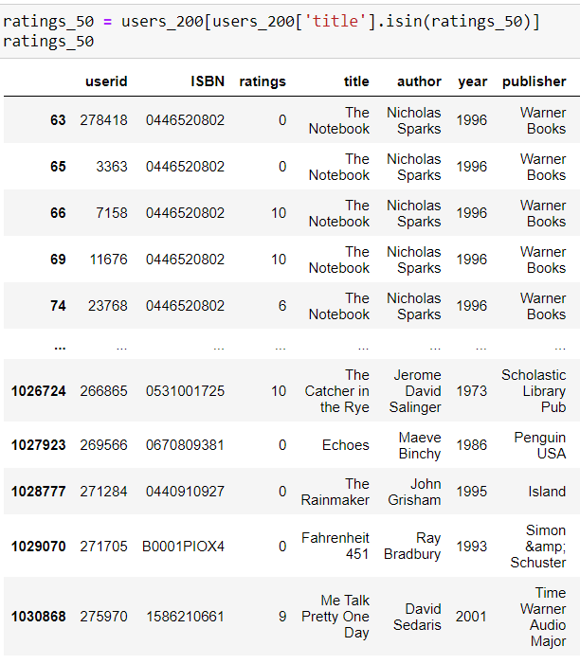
2. Collaborative based
Dataframe
In Collaborative based Recommendation we will choose only those users who have rated more than 200 books as these users are profession readers and the books that have more than 50 times ratings. We cannot recommend books based on the readers who have read only few books.
In this way our Recommendation System will give accurate recommendations.

Slide 17
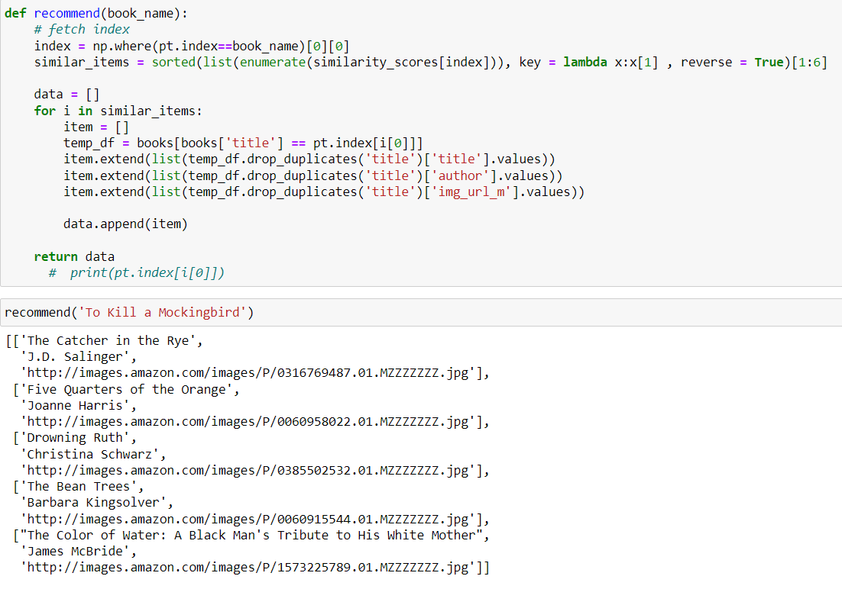
In this Model we used Cosine similarity from library:- sklearn.metrics.pairwise
Here we can see a function that recommends books along with author name, publisher name and book image too

Slide 18
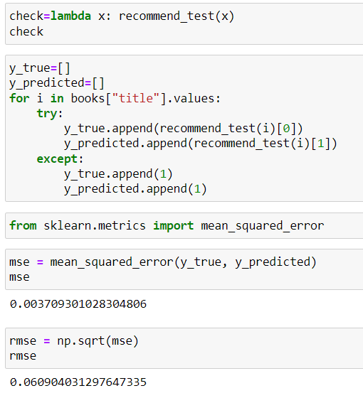
Model Evaluation for Collaborative based
Here we can see the
Mean Square Error as 0.003 that is 0.3%
And
Root Mean Squared Error as 0.06 that is 6%
This means that the model is performing good and we decidef to deply Collaborative based model

Slide 19

Deployment

Slide 20

Thankyou

